Slide 1
Google Play Store

Slide 2

DATASET- Google PlayStore
Dataset-Link : https://www.kaggle.com/gauthamp10/google-playstore-apps

Slide 3
PROBLEM STATEMENT
The Google Play Store includes apps like books, magazines, music, movies, and television programs etc. This store provides various applications like Office suits for business, Excel reader, True caller for communication, Baby panda: dental care for education, Loud player free for music etc, now Google announced that it would let developers set sales for their apps, with the original price struck out and a banner underneath informing users when the sale ends.
Applications are available through Google Play either free of charge or at a cost. They can be downloaded directly on an Android device through the Proprietary Play Store mobile app or by Deploying the application to a device from the Google Play website. The store recommended applications to its users based on their trending once these users search in the store. Users might browse the recommended applications and install it immediately.
Instant Reliable Connection. Users believe that mobile apps available on Google Play Store are not potential threats to their mobile phones. They reckon that there will be no viruses. These apps will not cause any security threats to their existing data and personal information on the phone.
The problem is that the Very few developers and no companies want to write code without getting paid. Android application is not an exception to this rule. On the other hand, we can find thousands of applications available in the market-place, free to download. How companies earn money while they make their applications available without a download fee?
To predict the ratings of the App (before/after launching it on Play Store).
This is clearly a regression problem

Slide 4

Descriptive Statistics And EDA

Slide 5
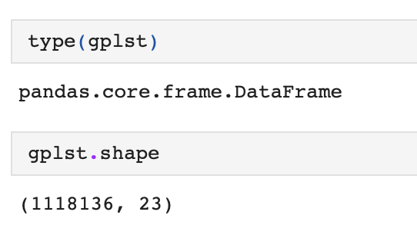
Understanding the Dataset
Dimensions & Type of Dataset
Dataset :-
Google-Playstore.csv

Slide 6
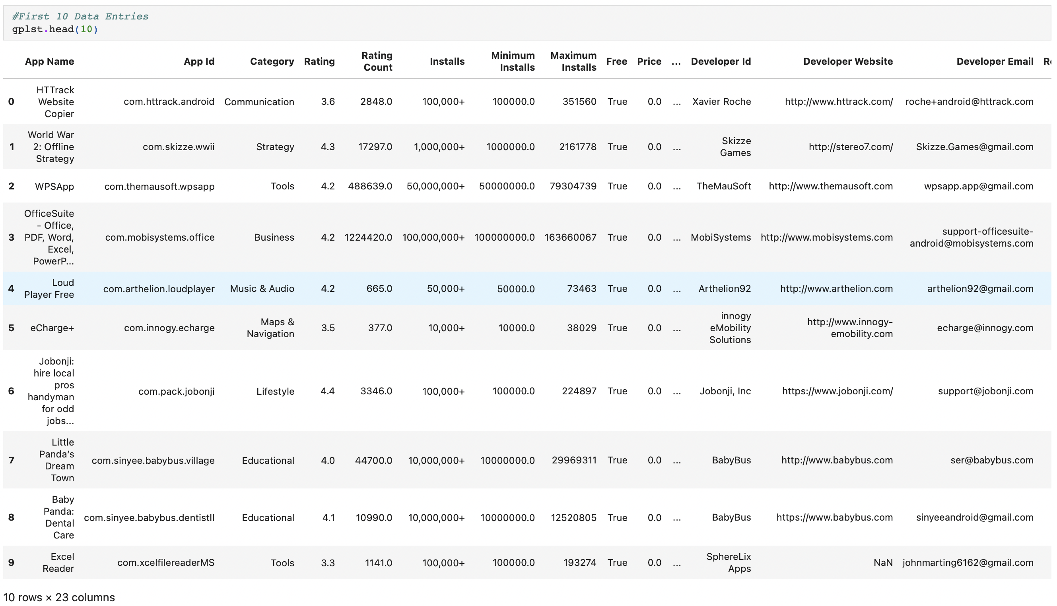
Head()

Slide 7
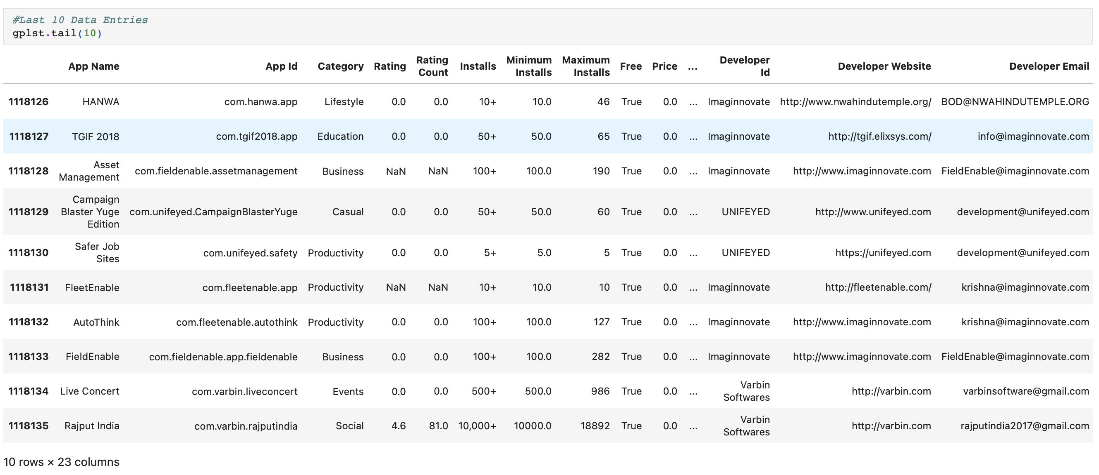
Tail()

Slide 8
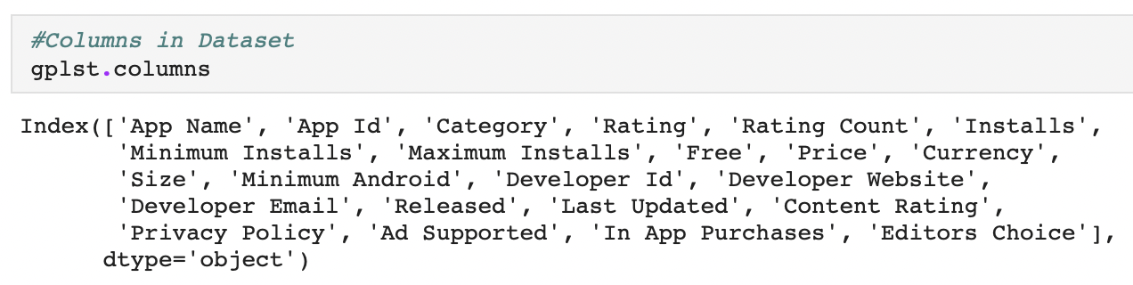
Columns in Dataset

Slide 9
Finding unique values
We will use info() function for datatype, count and other parameters .
Also we nunique() functions helps us to find out the total unique values as it can be further classifies as numeric, ordinal or categorical.

Slide 10
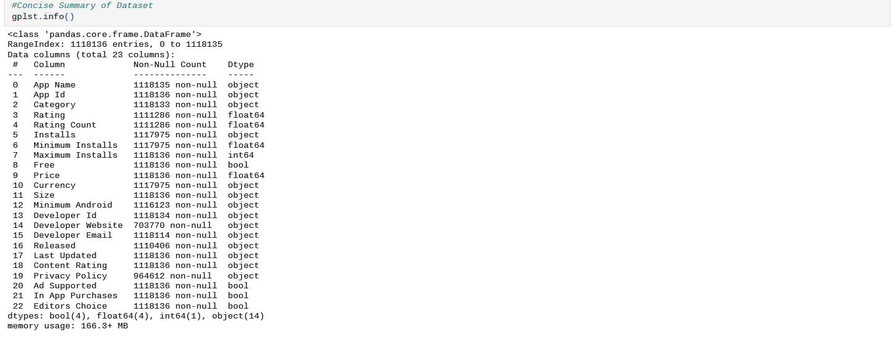
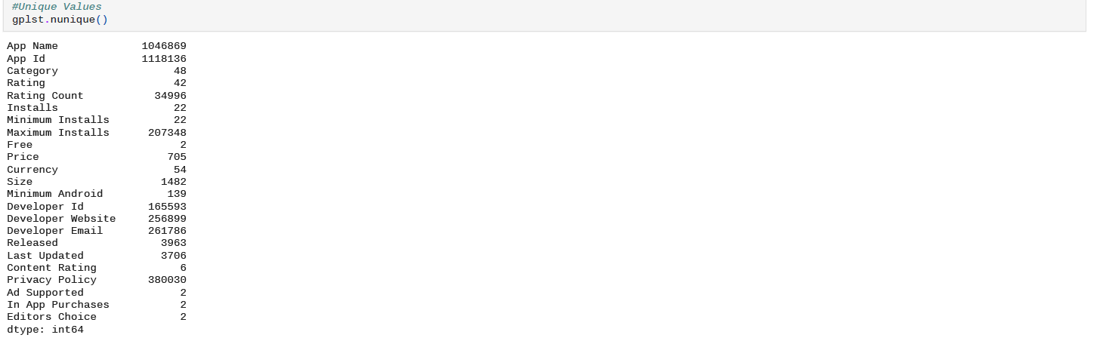
Summary & Unique values

Slide 11
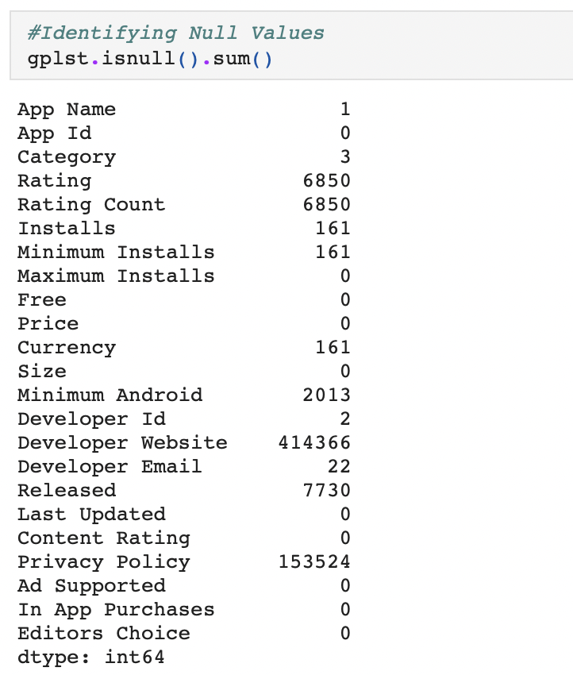
Null values

Slide 12
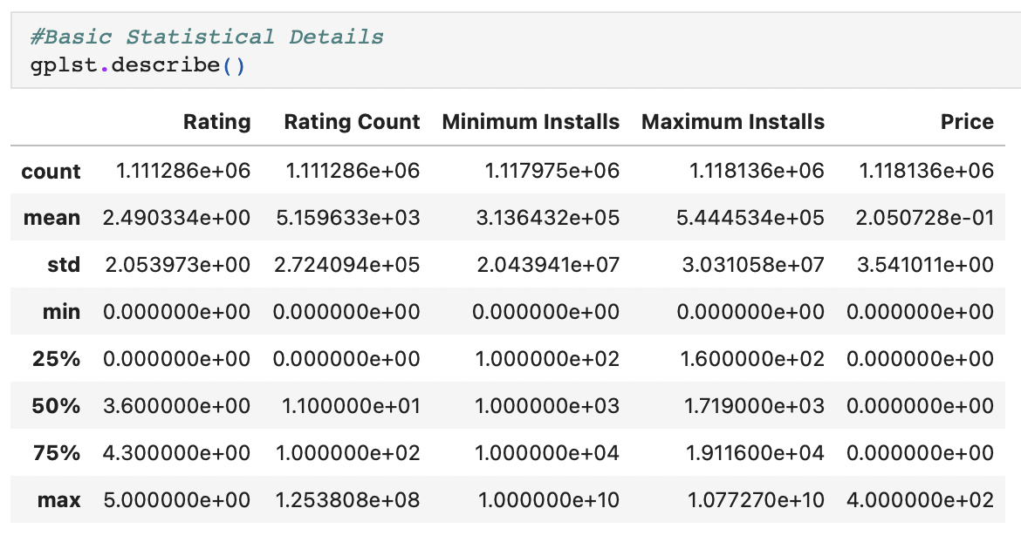
Basic Statistical Details

Slide 13
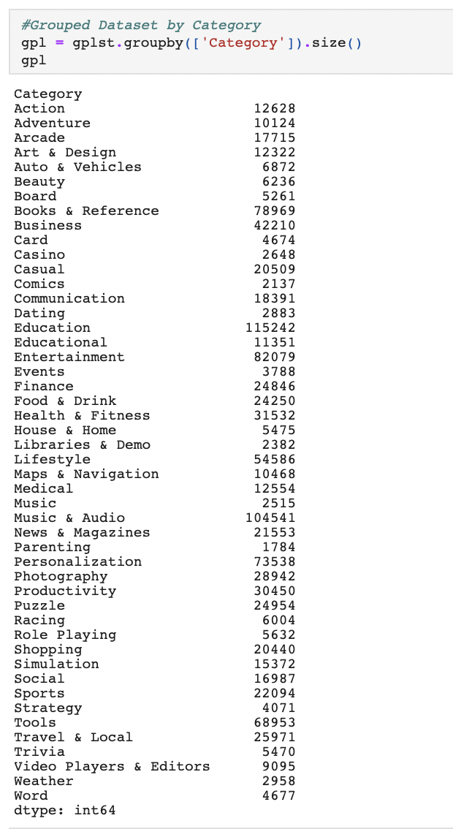
Grouped Dataset by ‘Category’

Slide 14

Visualizations

Slide 15
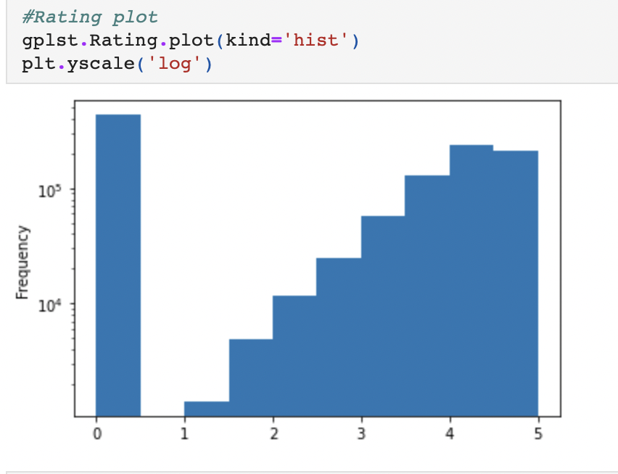
Rating Plot

Slide 16
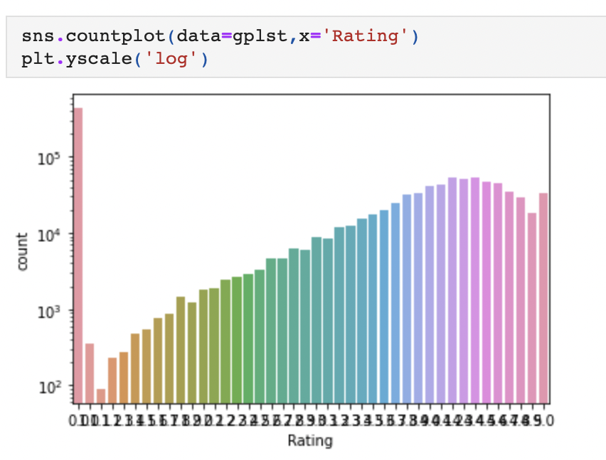
Count Plot

Slide 17
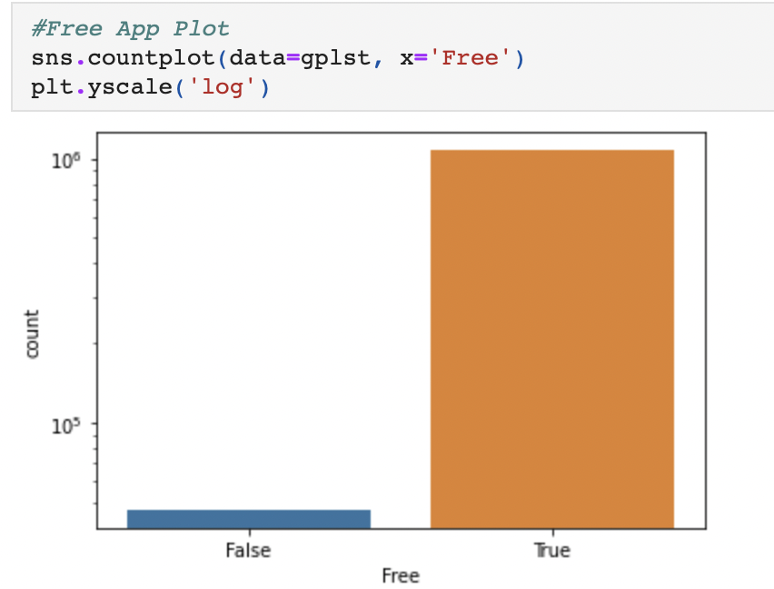
Free-App Plot

Slide 18
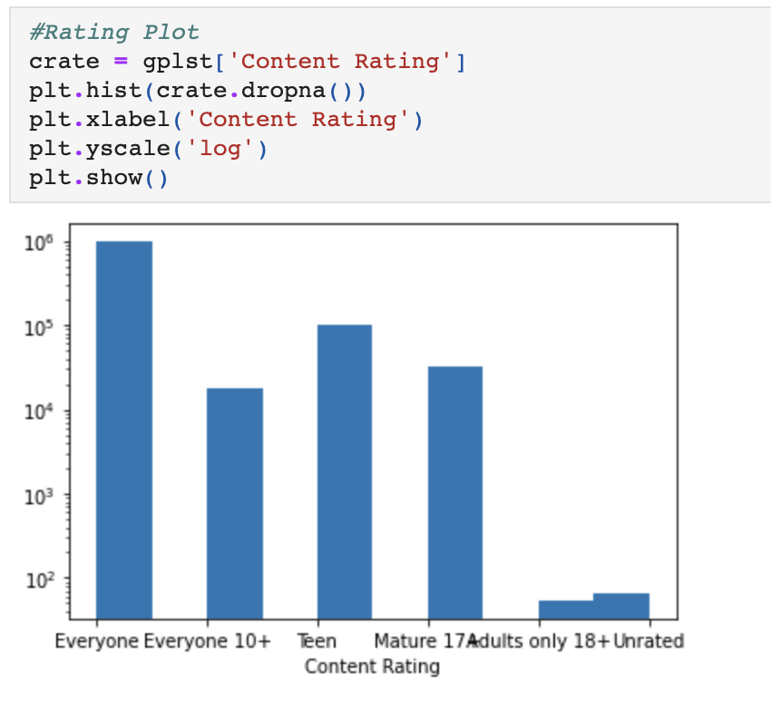
Rating Plot

Slide 19
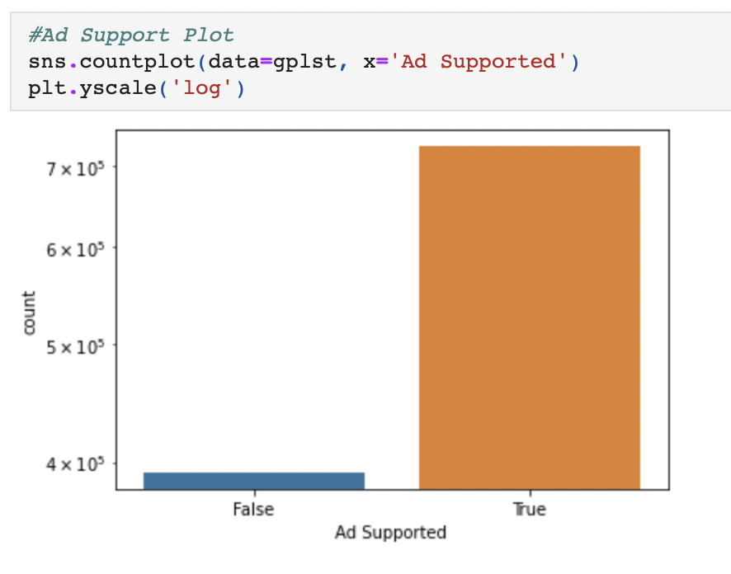
Ad-Support Plot

Slide 20
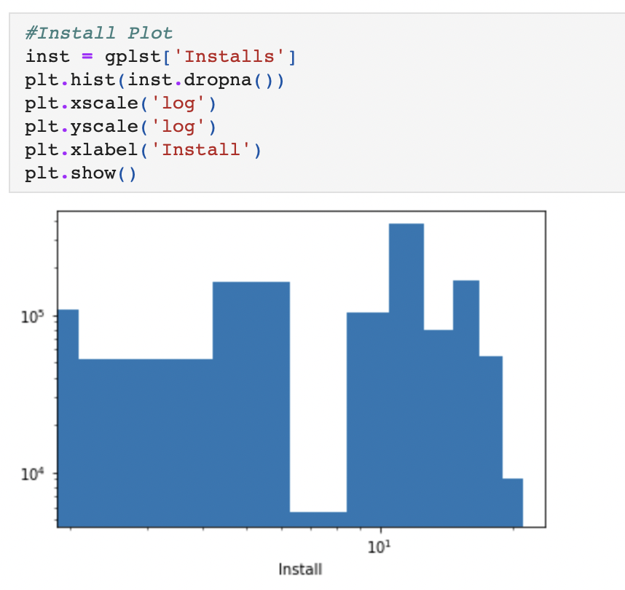
Install Plot

Slide 21
Finding outliers through boxplots

Slide 22
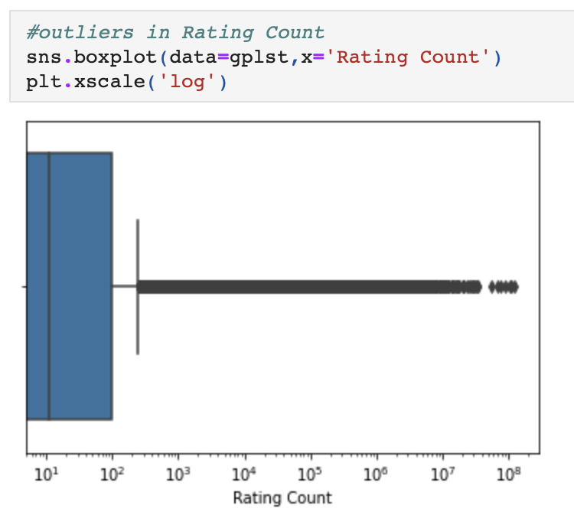
Outliers in Rating Count

Slide 23
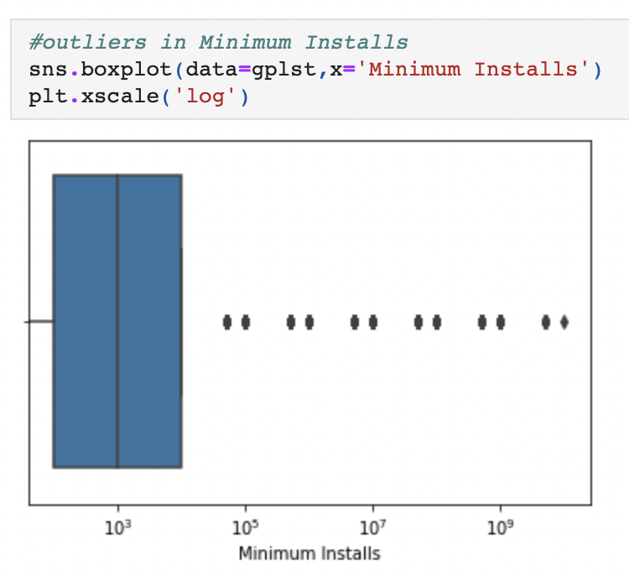
Outliers in Minimum Installs

Slide 24
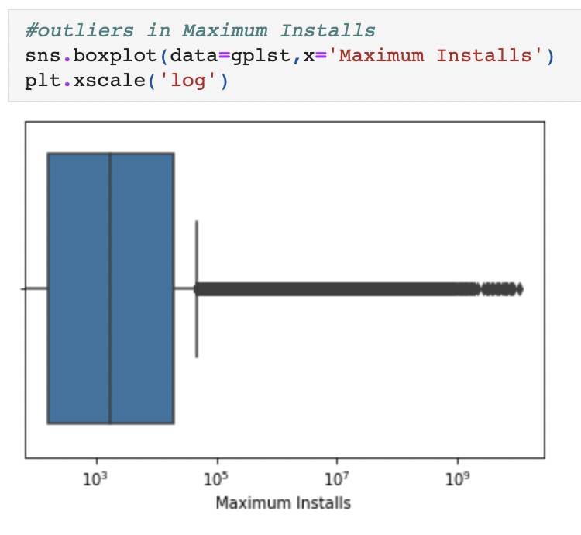
Outliers in Maximum Installs

Slide 25
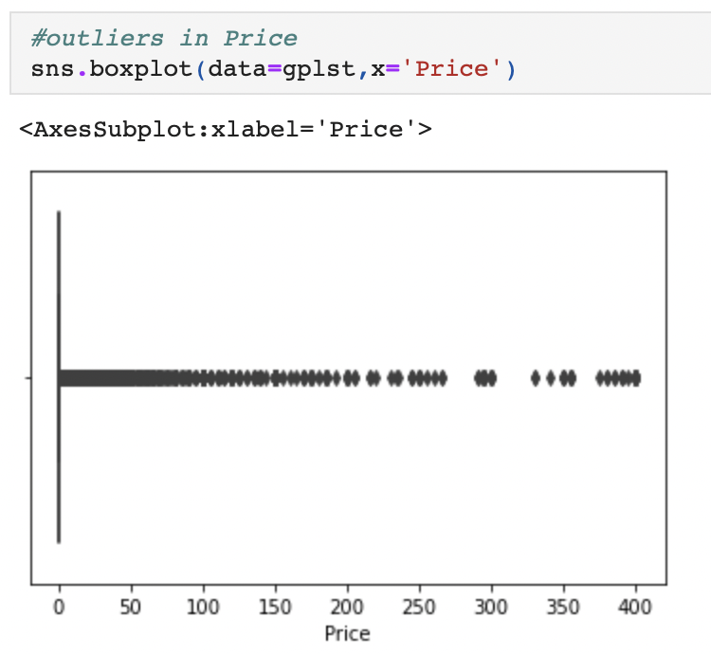
Outliers in Price

Slide 26
GithUb link for Code of exploratory data analysis
https://github.com/Vishal26199/Google-Playstore

